Slide 1
Snowflake
Lecturer: Ngo Huy Bien
Software Engineering Department
Faculty of Information Technology
University of Science
Ho Chi Minh City, Vietnam
nhbien@fit.hcmus.edu.vn

Slide 2

Objectives

Slide 3

Contents

Slide 4

References
Alan Beaulieu (2023). Learning Snowflake SQL and Scripting. O'Reilly Media.
Joyce Avila (2023). Snowflake - The Definitive Guide. O'Reilly Media.

Slide 5
Relational Database Primer [1]
Oracle, Sybase, SQL Server (Microsoft), and Db2 (IBM).

Slide 6
Snowflake
First launched in 2014, Snowflake is a cloud-based, full-featured, relational database.
Snowflake databases can be hosted on any of the three major cloud platforms (Amazon AWS, Microsoft Azure, and Google Cloud), which allows customers with existing cloud deployments to stick with what they know.
Both storage and compute engines can be scaled on demand, and Snowflake’s software as a service (SaaS) model frees companies from the need to hire legions of network, server, and database administrators, allowing organizations to focus on their core business.

Slide 7
Why Snowflake? [2]
Many of the major data warehouse providers, such as Oracle and IBM, that were created as a traditionally hosted solution later adapted to the cloud environment.
Unlike those traditional solutions, Snowflake was built natively for the cloud from the ground up.

Slide 8
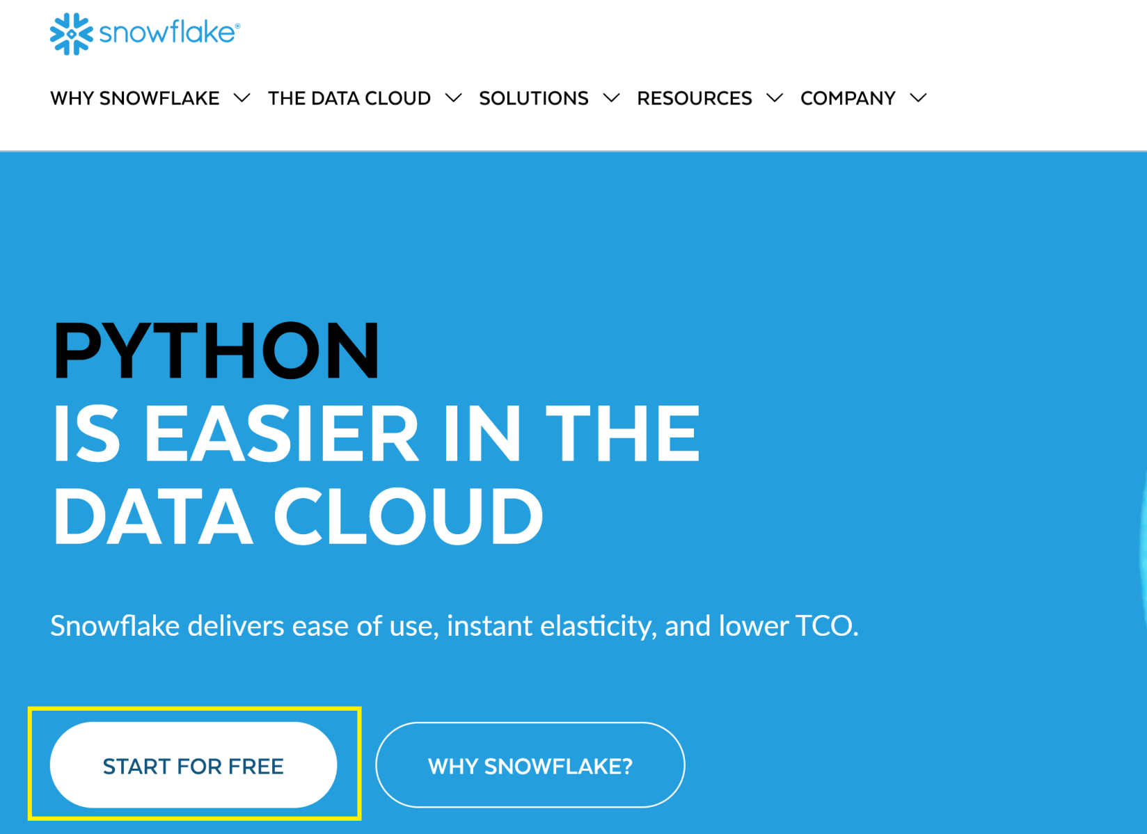
1. Register an Account
https://www.snowflake.com/en/

Slide 9
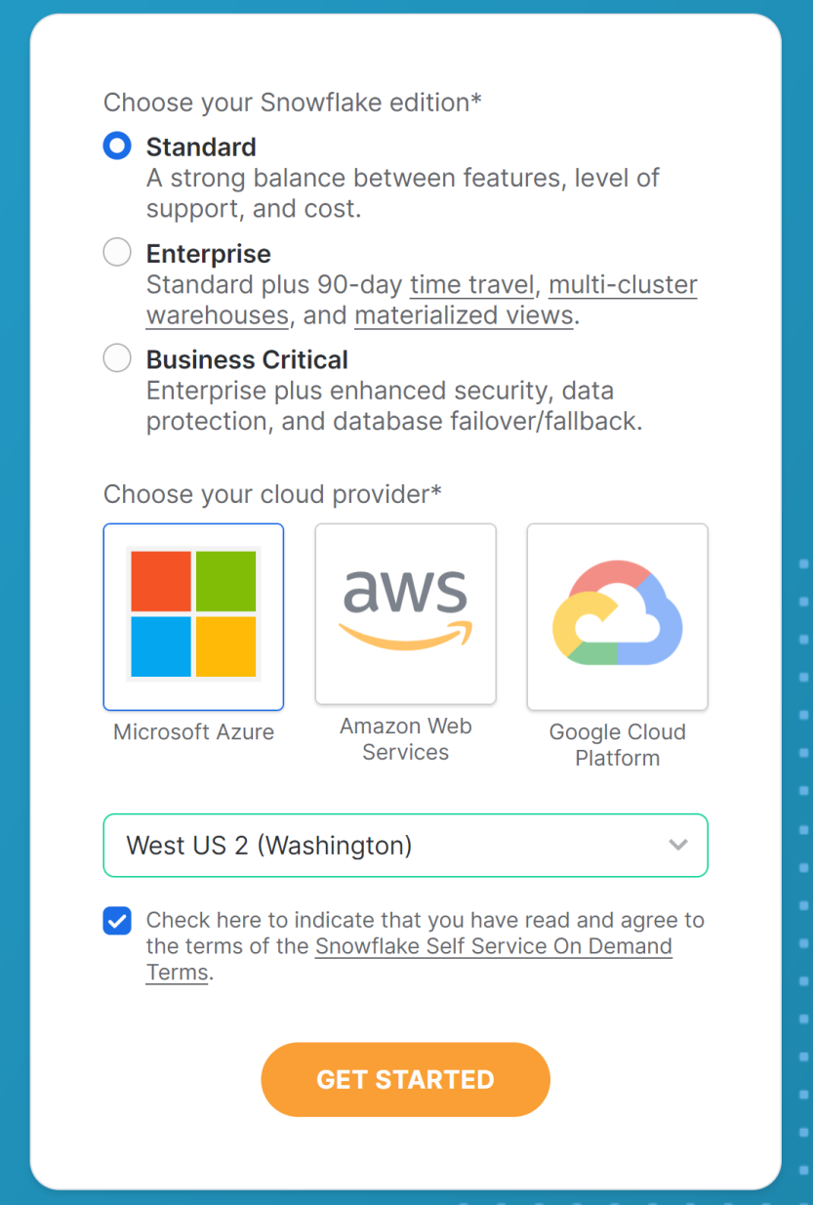
2. Select Options

Slide 10
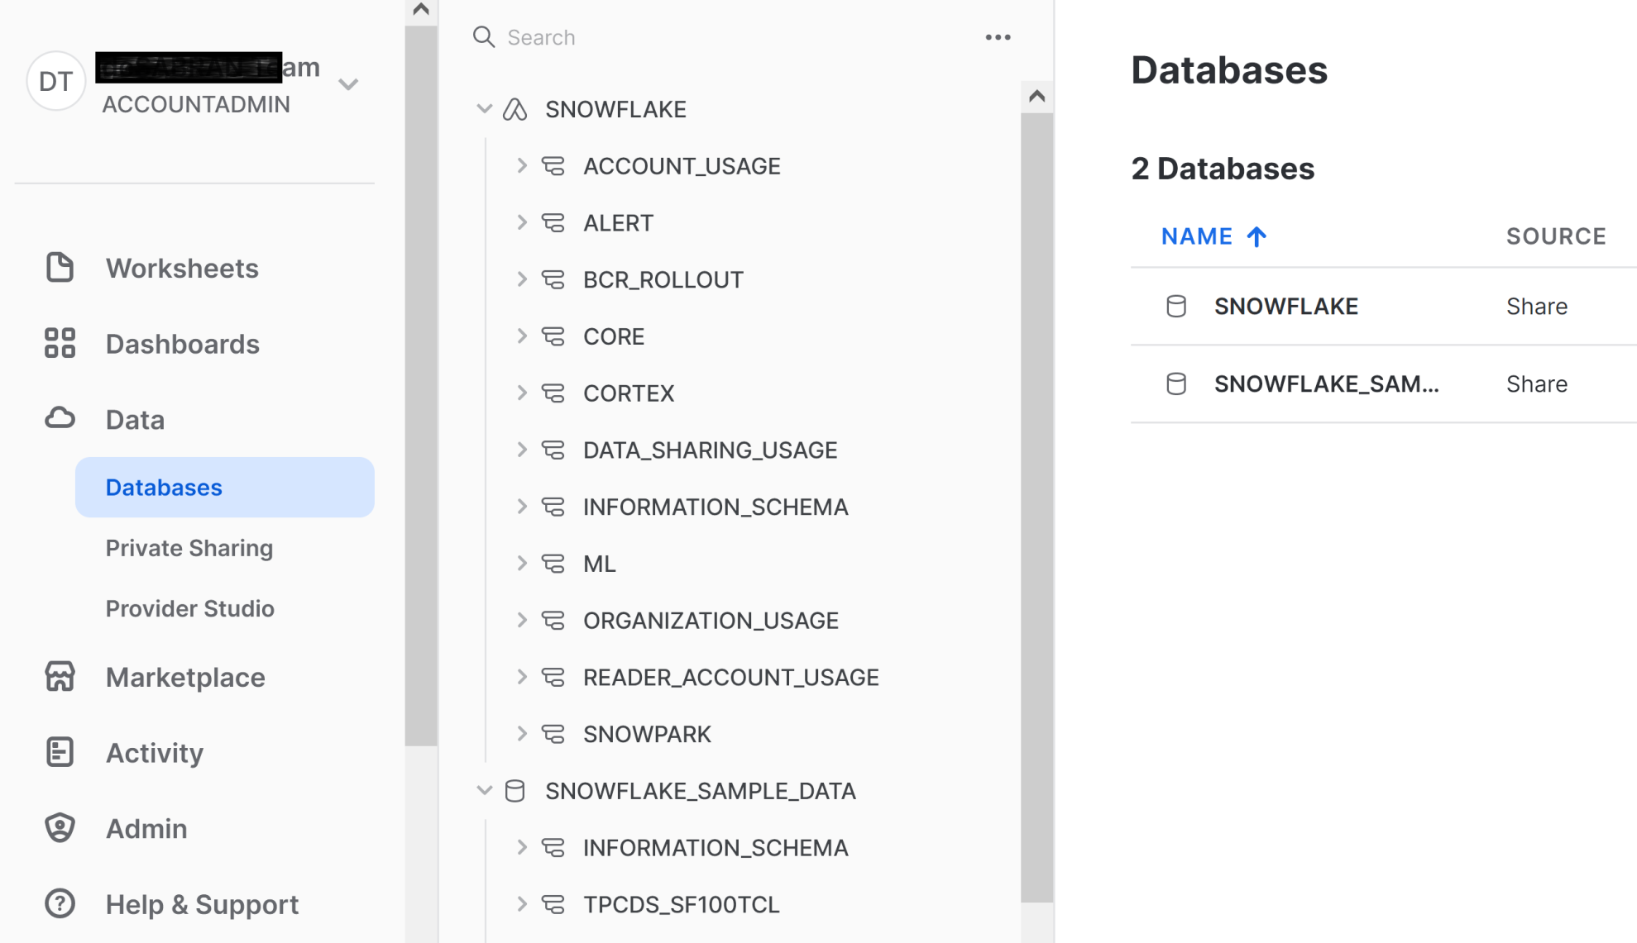
3. Review Web User Interfaces

Slide 11
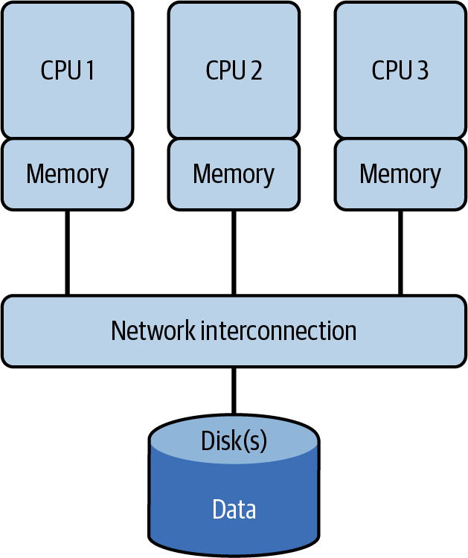
Shared-Disk (Scalable) Architecture
While the approach is simple in theory, it requires complex on-disk locking mechanisms to ensure data consistency which, in turn, causes bottlenecks.
Data concurrency, allowing many users to affect multiple transactions within a database, is also a major problem, and adding more compute nodes only compounds the problem in a shared-disk architecture.
Therefore, the true scalability of this architecture is limited.
Oracle RAC is an example of a shared-disk architecture.

Slide 12
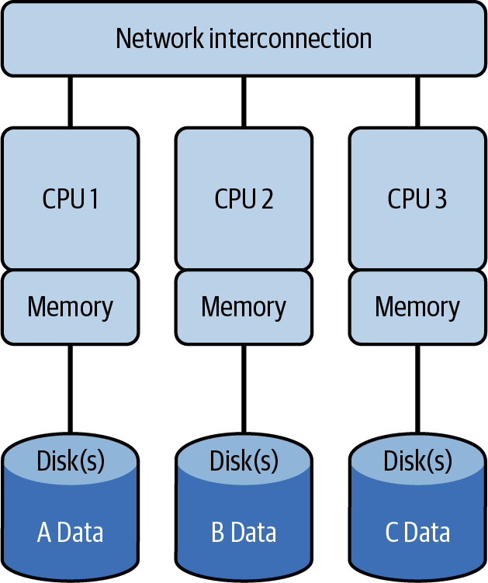
Shared-Nothing (Scalable) Architecture
Distributed cluster nodes along with the associated disk storage, CPU, and memory requires data to be shuffled between nodes, which adds overhead.
The way the data is distributed across the nodes will determine the extent of the additional overhead.
Examples of a
shared-nothing architecture include IBM DB2, Vertica, and Pivotal Greenplum.

Slide 13
NoSQL Alternatives
Most NoSQL solutions rely on a shared-nothing architecture; thus, they have many of the same limitations.
A major limitation of NoSQL stores is that they perform poorly when doing calculations involving many records, such as aggregations, window functions, and arbitrary ordering.

Slide 14
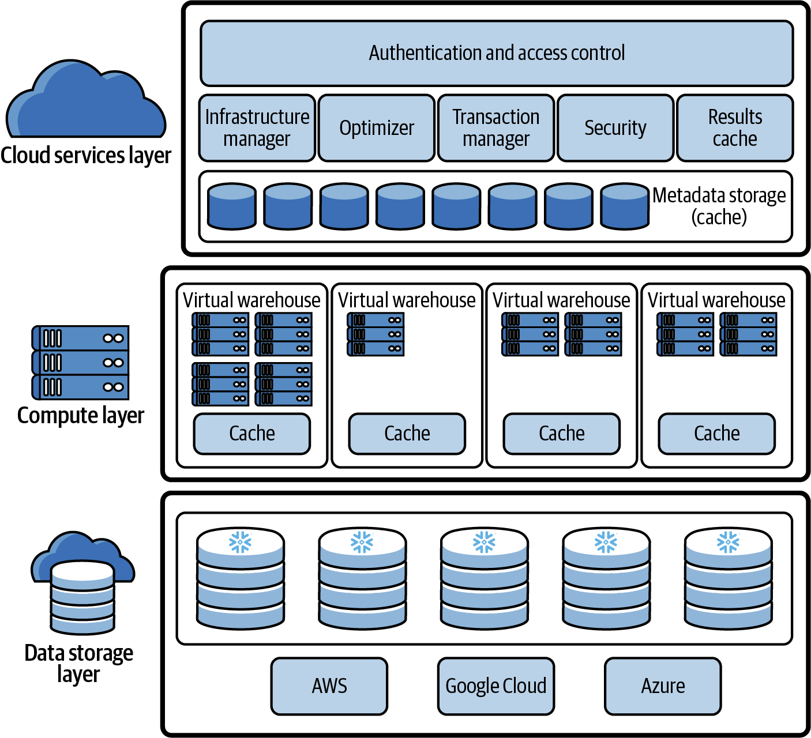
The Snowflake Architecture

Slide 15
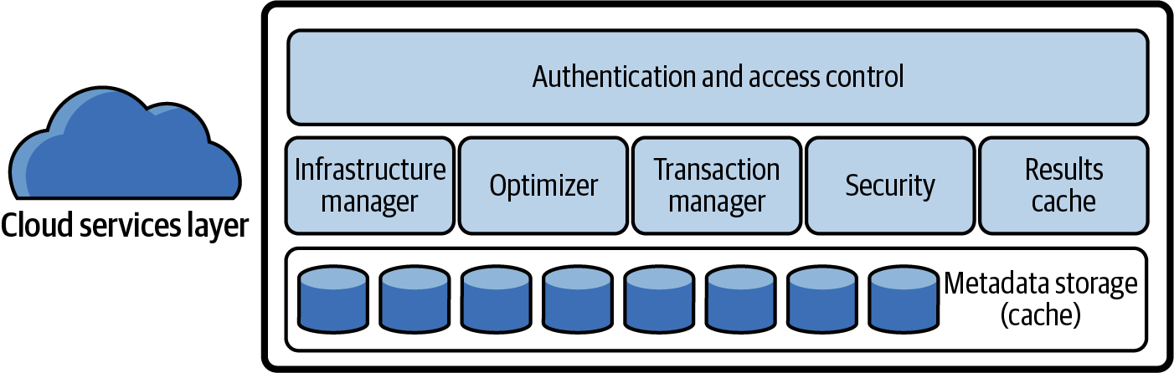
The Cloud Services Layer
Each time a user requests to log in, the request is handled by the cloud services layer.
When a user submits a Snowflake query, the SQL query will be sent to the cloud services layer optimizer before being sent to the compute layer for processing.
The cloud services layer is what enables the SQL client interface for Data Definition Language (DDL) and Data Manipulation Language (DML) operations on data.

Slide 16
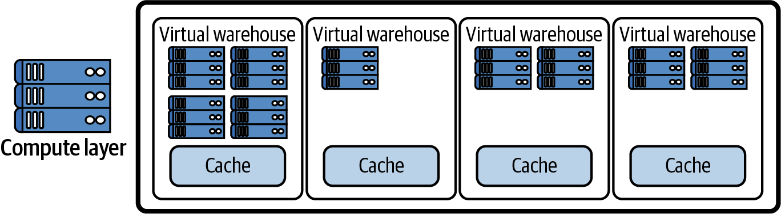
The Query Processing (Virtual Warehouse) Compute Layer
A Snowflake compute cluster, most often referred to simply as a virtual warehouse, is a dynamic cluster of compute resources consisting of CPU memory and temporary storage.
A running virtual warehouse is required for most SQL queries and all DML operations, including loading and unloading data into tables, as well as updating rows in tables.

Slide 17
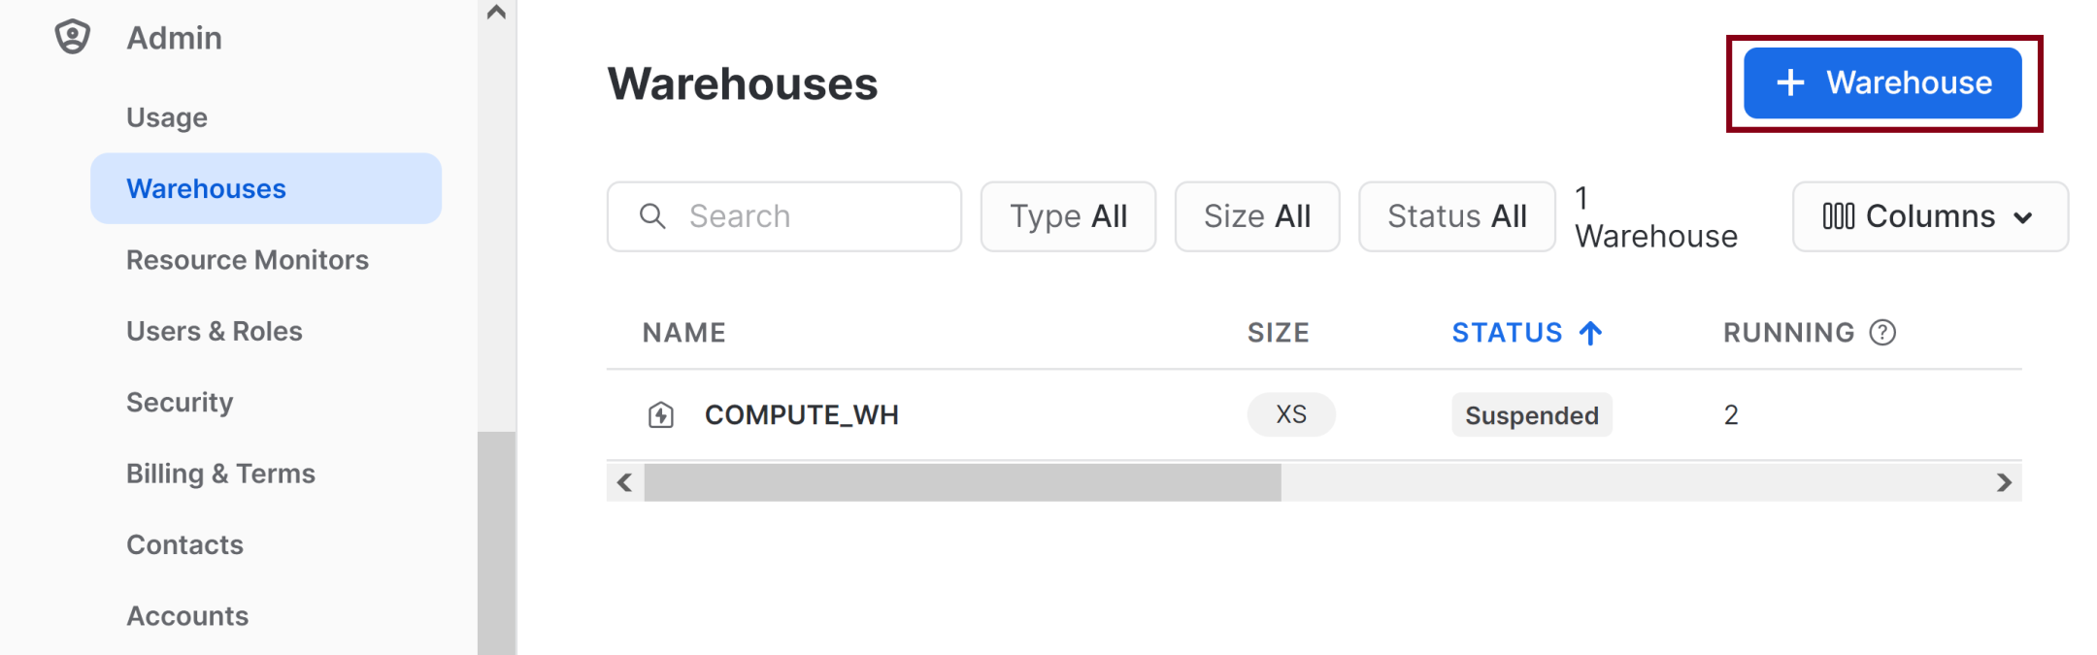
1. Create a Warehouse

Slide 18
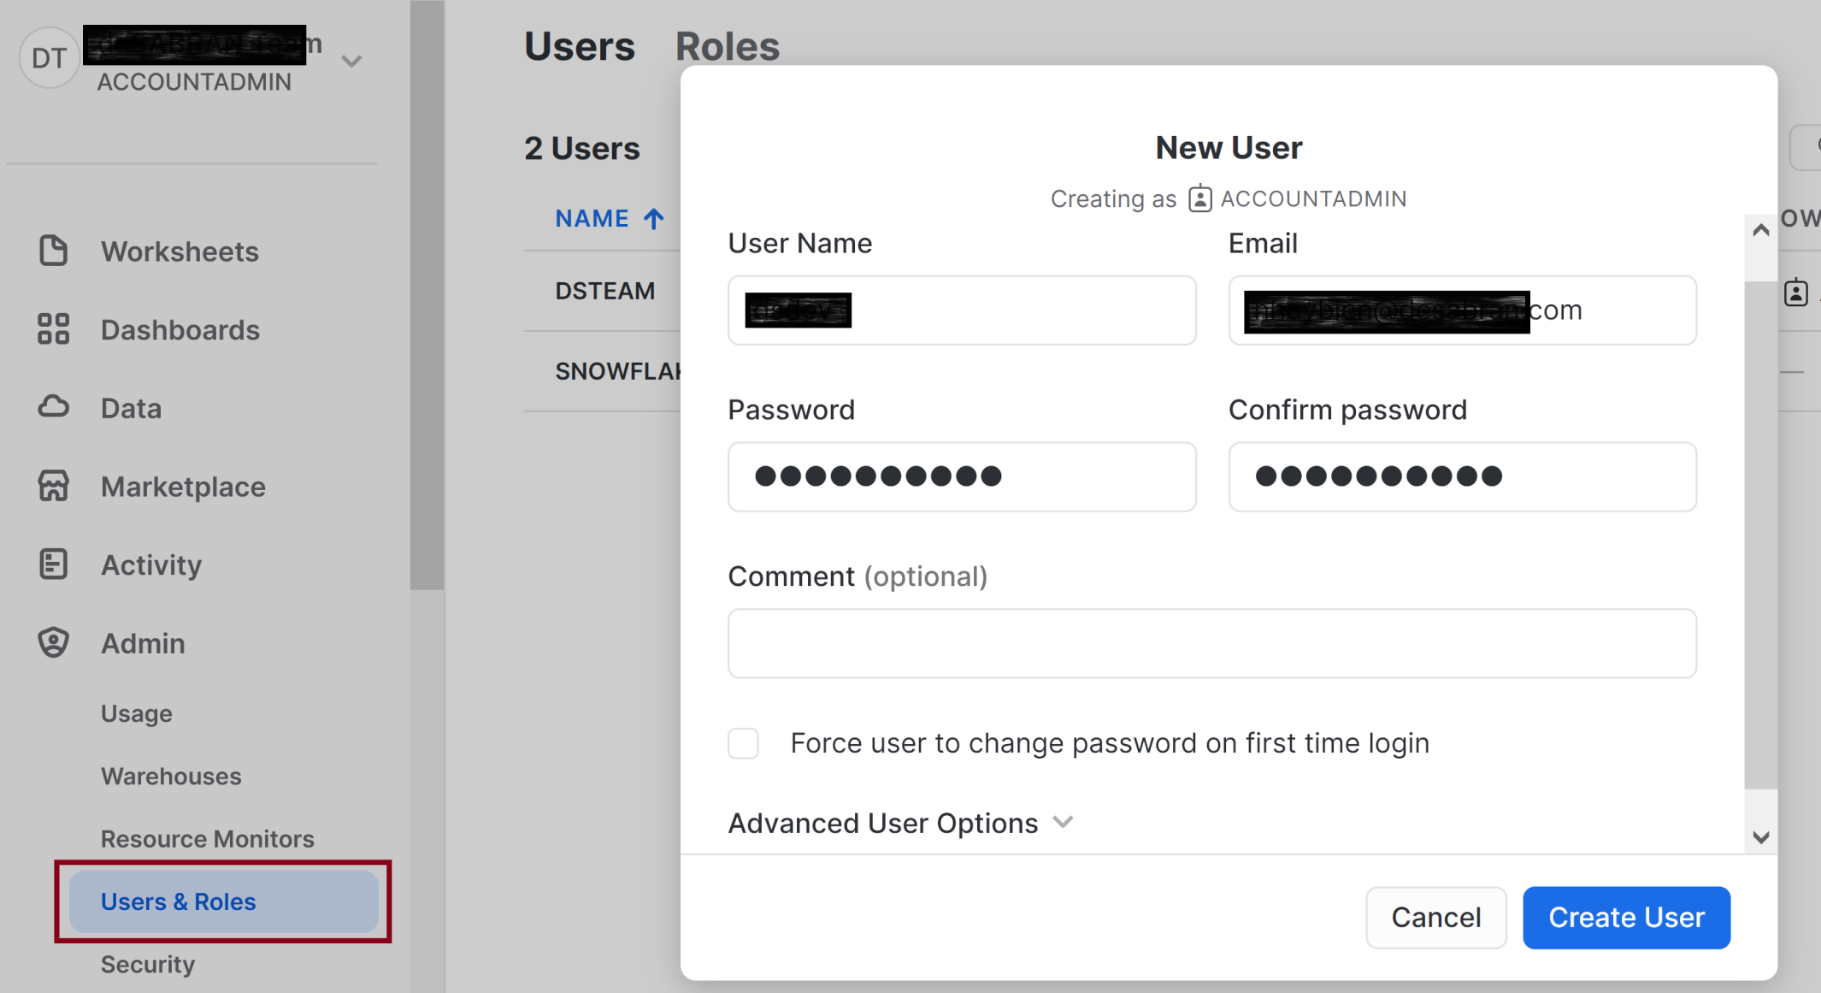
2. Create a User

Slide 19
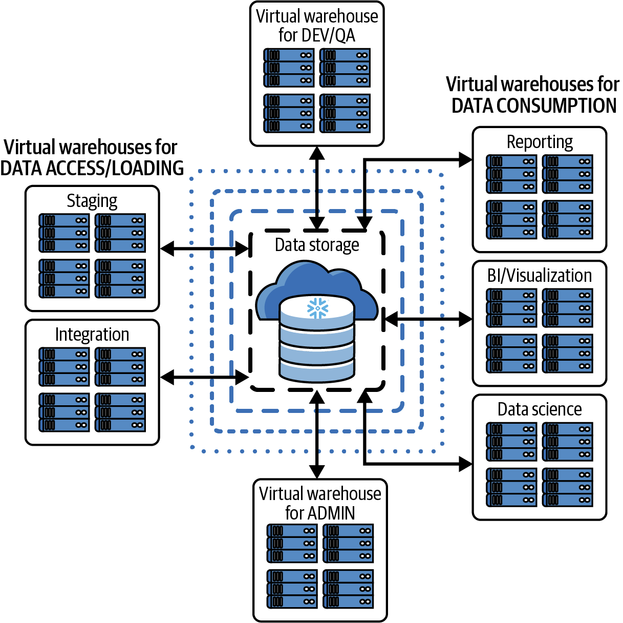
Separating Snowflake Workloads
Assigning different virtual warehouses to groups of users.

Slide 20
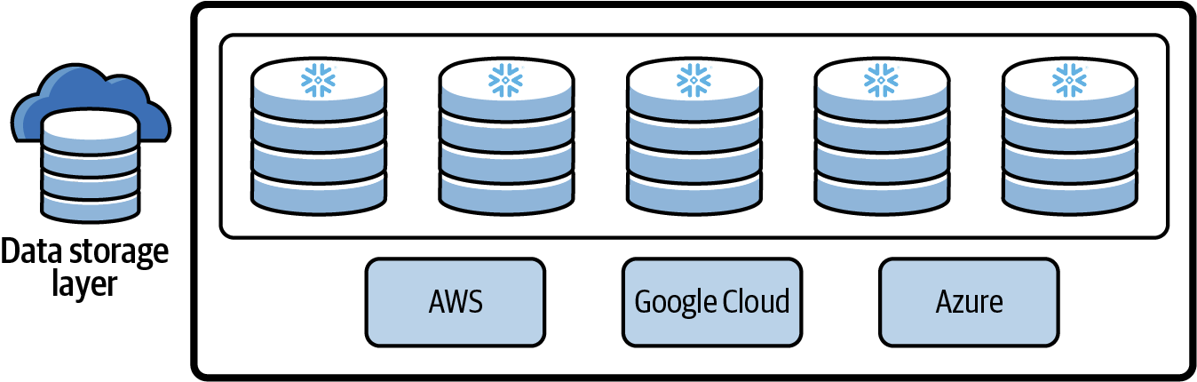
Centralized (Hybrid Columnar) Database Storage Layer
Snowflake’s centralized database storage layer holds all data, including structured and semi-structured data.
As data is loaded into Snowflake, it is optimally reorganized into a compressed, columnar format and stored and maintained in Snowflake databases.
Each Snowflake database consists of one or more schemas, which are logical groupings of database objects such as tables and views.

Slide 21
Compression and Encryption
Data stored in Snowflake databases is always compressed and encrypted.
Snowflake takes care of managing every aspect of how the data is stored.
Snowflake automatically organizes stored data into micro-partitions, an optimized, immutable, compressed columnar format which is encrypted using AES-256 encryption. Snowflake optimizes and compresses data to make metadata extraction and query processing easier and more efficient.

Slide 22
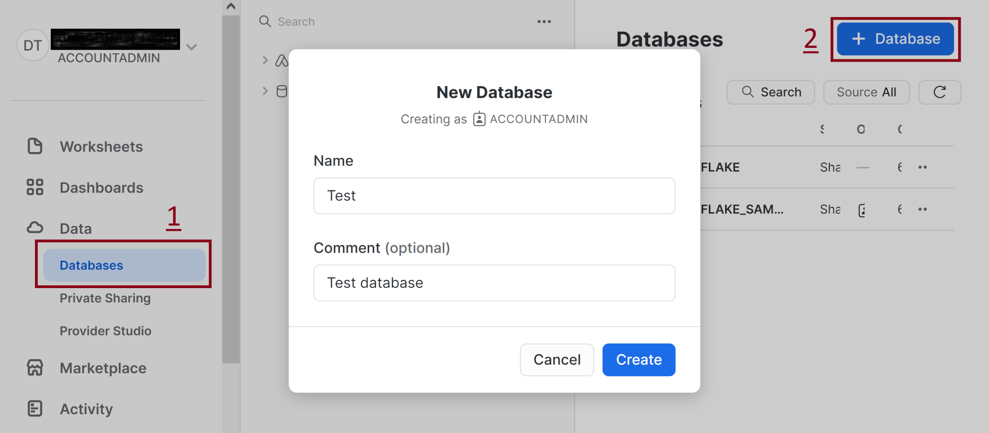
3. Create a Database

Slide 23
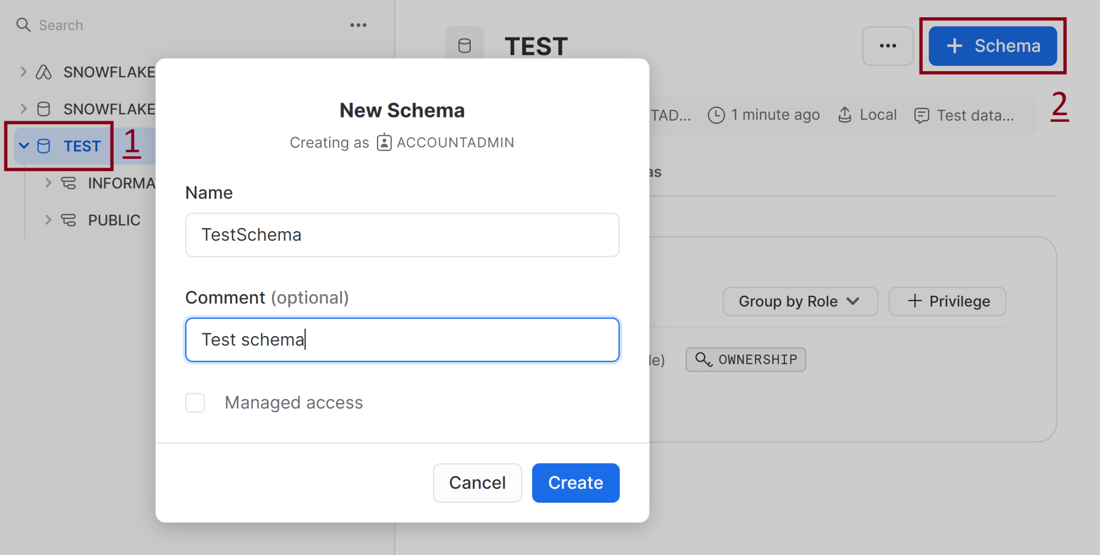
4. Create a Schema

Slide 24
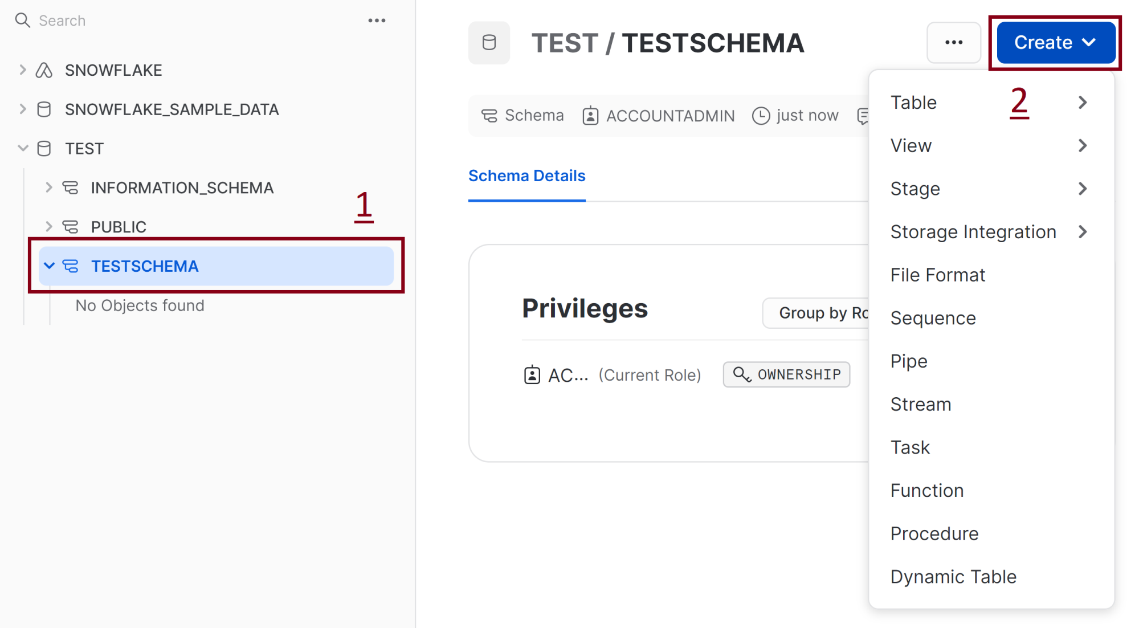
5. Create Table

Slide 25
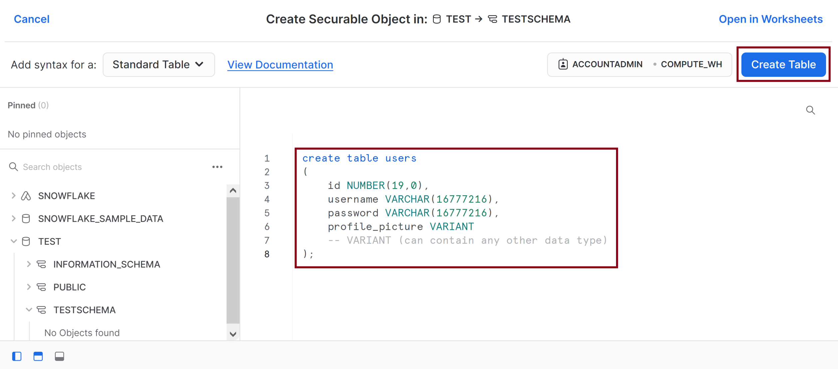
6. Enter SQL Code
create table users
(
id NUMBER(19,0),
username VARCHAR(16777216), password VARCHAR(16777216), profile_picture VARIANT -- VARIANT (can contain any other data type)
);

Slide 26


Slide 27
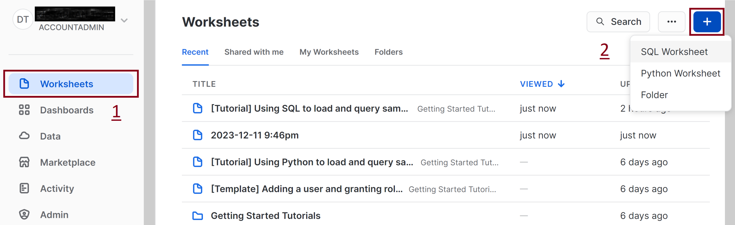
1. Create SQL Worksheet

Slide 28
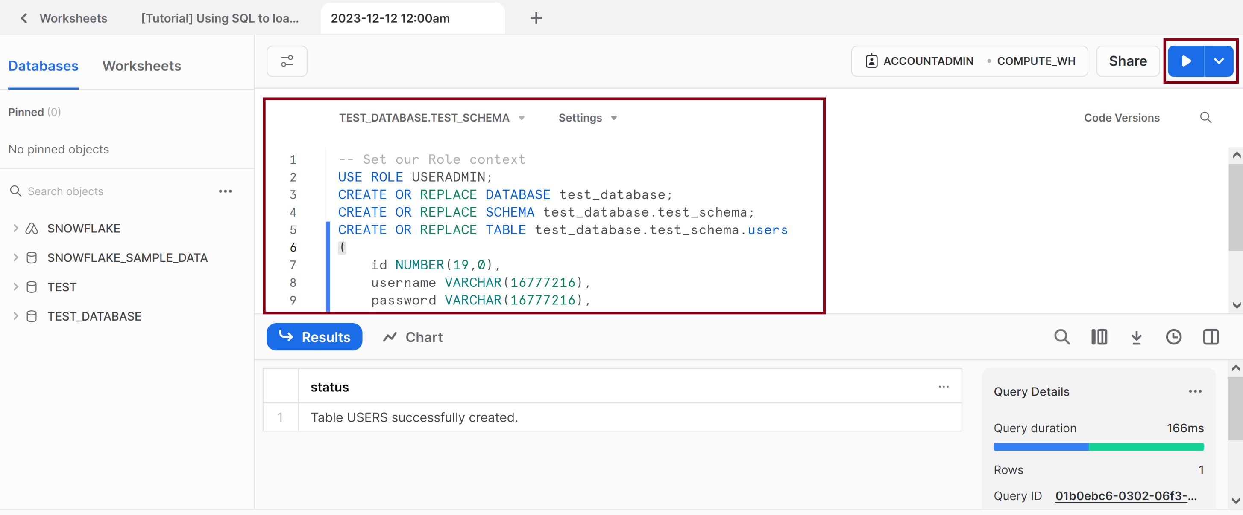
2. Enter and Execute SQL Code
-- Set our Role context
USE ROLE USERADMIN;
CREATE OR REPLACE DATABASE test_database;
CREATE OR REPLACE SCHEMA test_database.test_schema;
CREATE OR REPLACE TABLE test_database.test_schema.users
(
id NUMBER(19,0),
username VARCHAR(16777216),
password VARCHAR(16777216),
profile_picture VARIANT,
creation_date TIMESTAMP_LTZ -- TIMESTAMP_NTZ internally stores “wallclock” time with a specified precision. All operations are performed without taking any time zone into account.
);

Slide 30
Snowflake Key Features [2]
Pure Software-as-a-Service (SaaS) Experience
Database-as-a-Service (DBaaS)?
Relational
Support for ANSI SQL and ACID transactions.
Semi-Structured
Built-in functions and SQL extensions for traversing, flattening, and nesting of semi-structured data, with support for popular formats such as JSON and Avro.
Elastic
Storage and compute resources can be scaled independently and seamlessly.

Slide 31
Storage versus Compute
Snowflake separates storage and compute.
The two aspects are handled by two loosely coupled, independently scalable services.
Compute is provided through Snowflake's (proprietary) shared-nothing engine.
Storage is provided through Amazon S3.
To reduce network traffic between compute nodes and storage nodes, each compute node caches some table data on local disk.

Slide 32
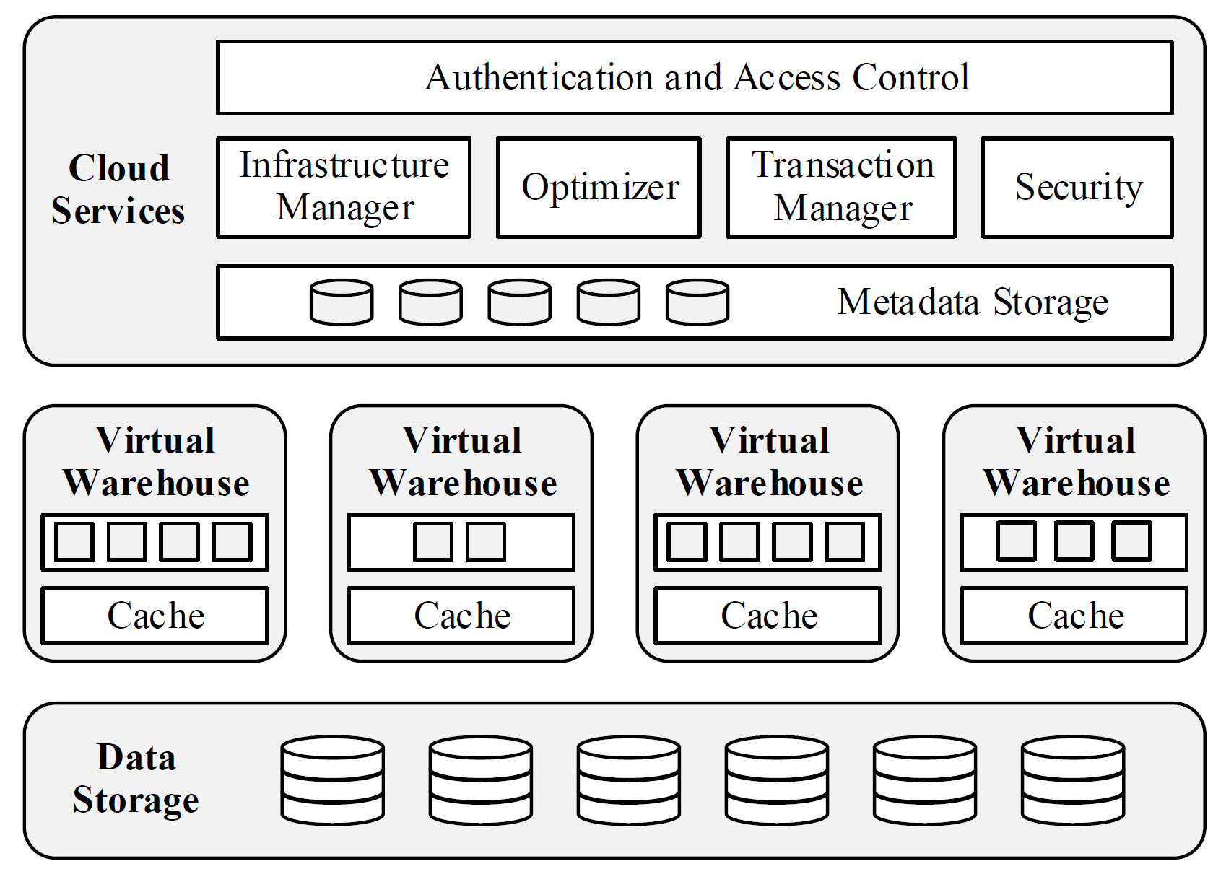
Multi-Cluster, Shared Data Architecture

Slide 33
Column-Stores
Daniel J. Abadi et al. (2008). Column-Stores vs. Row-Stores - How Different Are They Really.

Slide 34
Vectorized Execution
Andrew Pavlo et al. (2009). A Comparison of Approaches to Large-Scale Data Analysis.

Slide 35
Push-based Execution
Goetz Graefe (1994). Volcano - An Extensible and Parallel Query Evaluation System.

Slide 36
Snowflake OLTP
https://community.snowflake.com/s/question/0D50Z00008BDIPTSA5/snowflake-oltp
Regarding my (soon-to-be-obsolete) statement 4 years ago:
"Snowflake is NOT an appropriate platform for OLTP workloads. No question about that."
I am delighted to report that with the introduction of Hybrid Tables (to be formally announced at our Snowflake Summit in a couple of weeks), Snowflake will be able to handle OLTP workloads.
Hybrid Tables: https://www.snowflake.com/try-unistore/

Slide 37
Pricing
https://www.integrate.io/blog/redshift-vs-snowflake/
https://blog.panoply.io/redshift-vs-snowflake-the-full-comparison
Some of its competitors are Amazon Redshift or Google BigQuery. Redshift is less expensive compared to Snowflake on-demand pricing.

Slide 38

Thank You & See You Again

